Slide 1

DATA SCIENCE
Logistic Regression

Slide 2
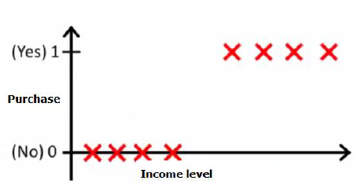

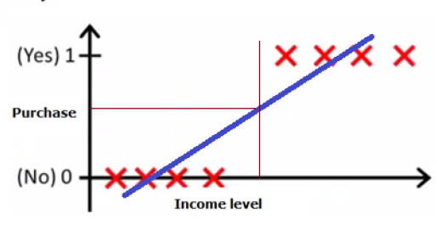
What happens if we apply Linear Regression on Classification problems?

Slide 3
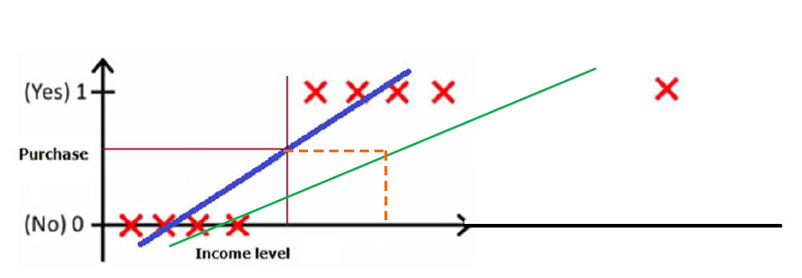
What happens if we apply Linear Regression on Classification problems?
IT COULD FAIL

Slide 4
Also…
The values from Linear Regression can be much greater than 0 and much smaller than 1
So we need another technique,
Logistic Regression
The output values are bounded between 0 and 1 and hence it is a lot more comprehensible

Slide 5
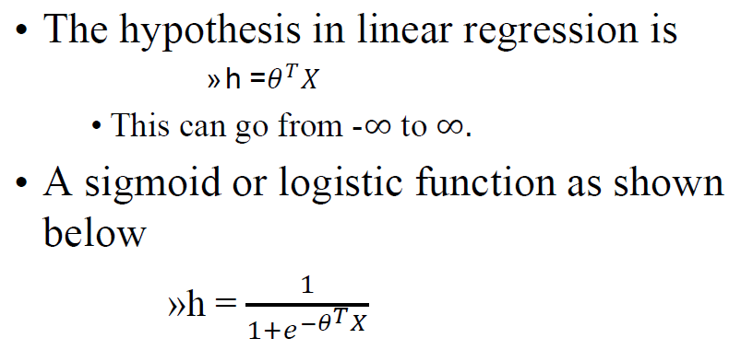
Logistic Regression

Slide 6
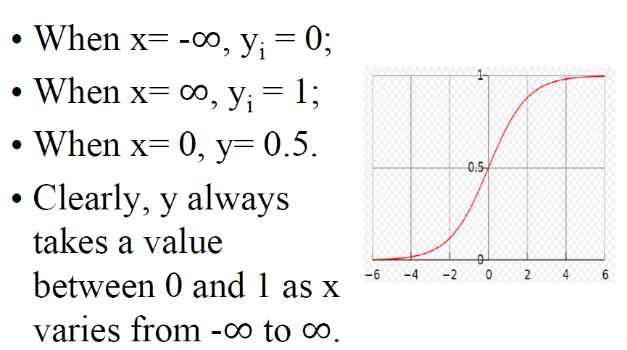
Understanding Sigmoid Function

Slide 7
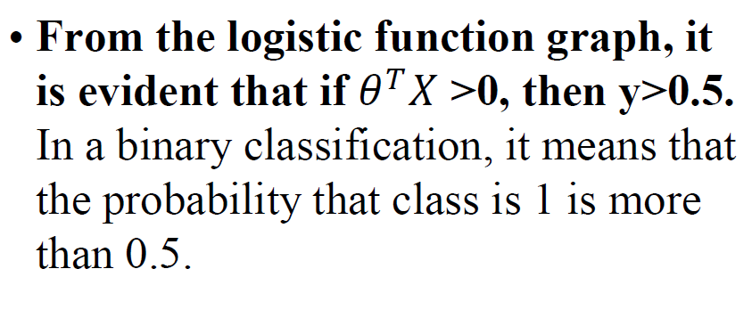
Logistic Regression

Slide 8
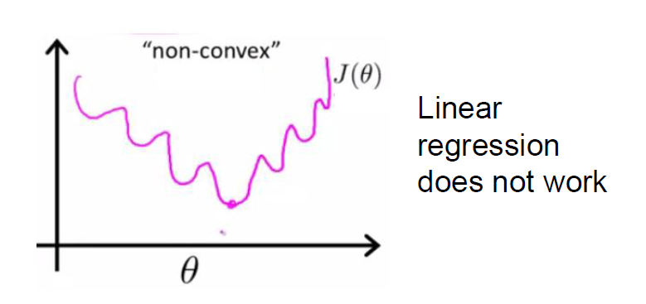
Cost Function
Linear Regression doesn’t work. Because the squared error loss function calculated using the Sigmoid function is a non convex function.

Slide 9
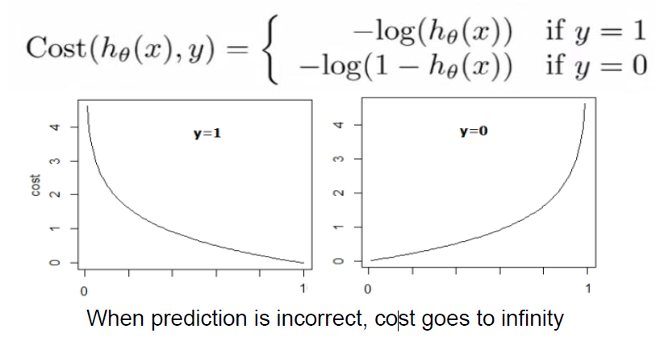
Cost Function – Logistic Loss

Slide 10
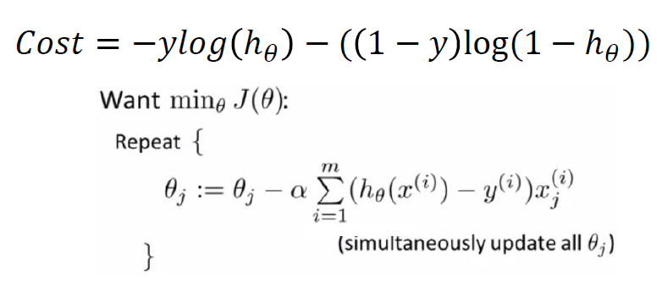
Cost Function – Logistic Loss
This is a convex function. And hence Gradient Descent can be applied as follows

Slide 11


Slide 12

Let’s

